Slide 1
BLM1612 - Circuit Theory
Prof. Dr. Nizamettin AYDIN
naydin@yildiz.edu.tr
www.yildiz.edu.tr/~naydin
Mathematical Preliminaries
Nodal Analysis
Nodal Analysis with Supernodes
Mesh Analysis
Mesh Analysis with Supermeshes

Slide 2
Objectives of Lecture
Provide step-by-step instructions for nodal analysis, which is a method to calculate node voltages and currents that flow through components in a circuit.
Provide step-by-step instructions for mesh analysis, which is a method to calculate voltage drops and mesh currents that flow around loops in a circuit.

Slide 3
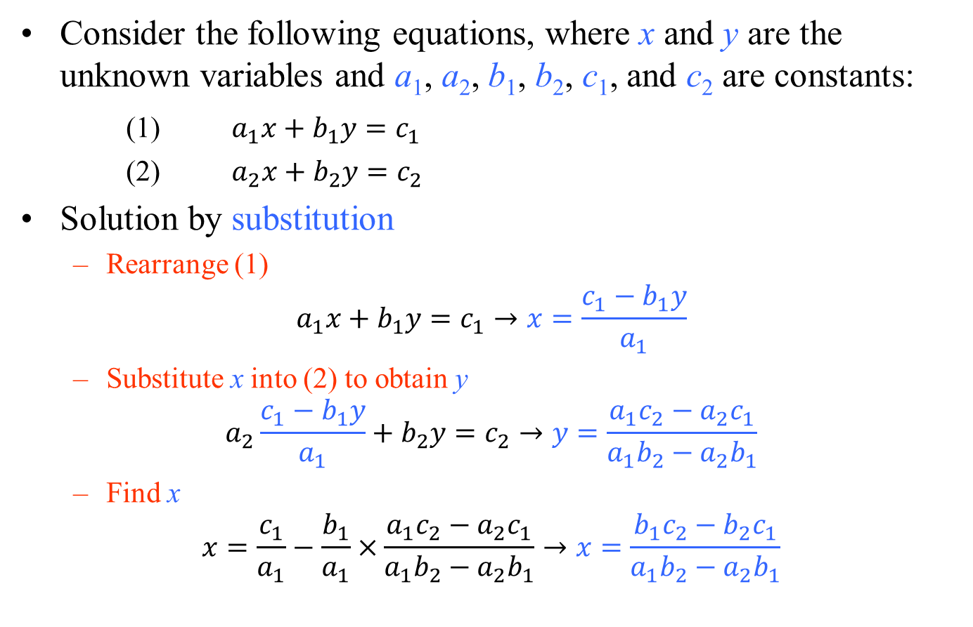
Mathematical Preliminaries
Consider the following equations, where x and y are the unknown variables and a₁, a₂, b₁, b₂, c₁, and c₂ are constants:
(1) $a_{1}x+b_{1}y=c_{1}$
(2) $a_{2}x+b_{2}y=c_{2}$
Solution by substitution
Rearrange (1)
$$a_{1}x+b_{1}y=c_{1}→x=\frac{c_{1}−b_{1}y}{a_{1}}$$
Substitute x into (2) to obtain y
$$a_{2}\frac{c_{1}−b_{1}y}{a_{1}}+b_{2}y=c_{2}→y=\frac{a_{1}c_{2}−a_{2}c_{1}}{a_{1}b_{2}−a_{2}b_{1}}$$
Find x
$$x=\frac{c_{1}}{a_{1}}−\frac{b_{1}}{a_{1}}×\frac{a_{1}c_{2}−a_{2}c_{1}}{a_{1}b_{2}−a_{2}b_{1}}→x=\frac{b_{1}c_{2}−b_{2}c_{1}}{a_{1}b_{2}−a_{2}b_{1}}$$

Slide 4
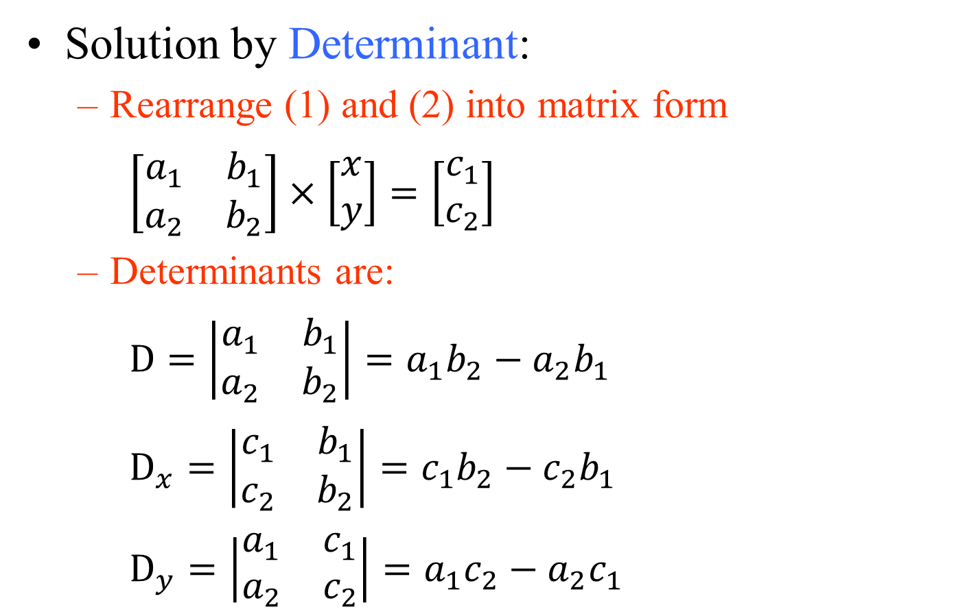
Mathematical Preliminaries
Solution by Determinant:
Rearrange (1) and (2) into matrix form
$\left[\begin{matrix}a_{1} & b_{1} \\ a_{2} & b_{2}\end{matrix}\right]×\left[\begin{matrix}x \\ y\end{matrix}\right]=\left[\begin{matrix}c_{1} \\ c_{2}\end{matrix}\right]$
Determinants are:
$D=\left|\begin{matrix}a_{1} & b_{1} \\ a_{2} & b_{2}\end{matrix}\right|=a_{1}b_{2}−a_{2}b_{1}$
$D_{x}=\left|\begin{matrix}c_{1} & b_{1} \\ c_{2} & b_{2}\end{matrix}\right|=c_{1}b_{2}−c_{2}b_{1}$
$D_{y}=\left|\begin{matrix}a_{1} & c_{1} \\ a_{2} & c_{2}\end{matrix}\right|=a_{1}c_{2}−a_{2}c_{1}$

Slide 5
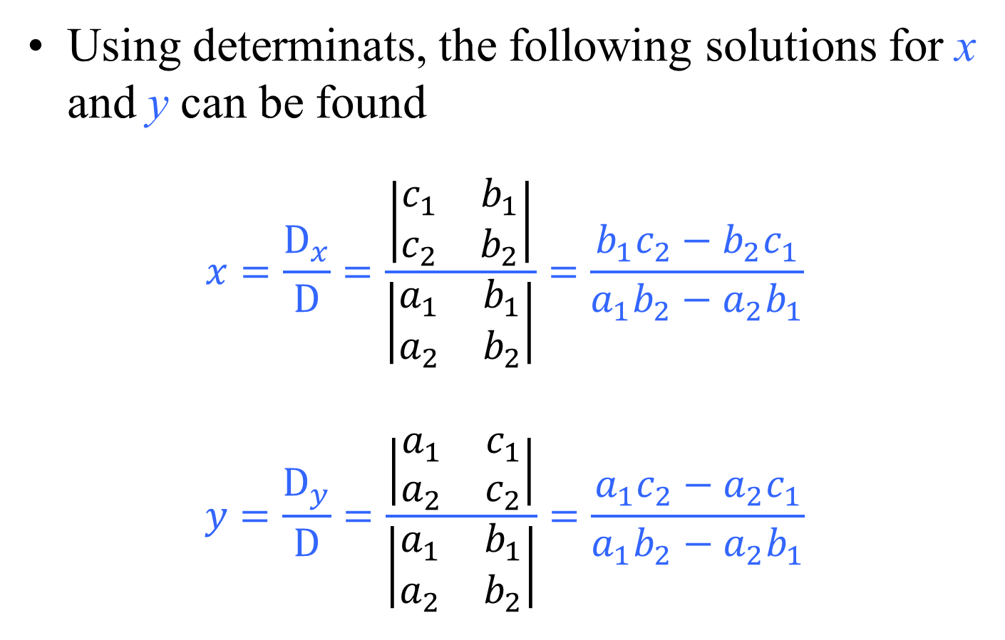
Mathematical Preliminaries
Using determinats, the following solutions for x and y can be found
$$x=\frac{D_{x}}{D}=\frac{\left|\begin{matrix}c_{1} & b_{1} \\ c_{2} & b_{2}\end{matrix}\right|}{\left|\begin{matrix}a_{1} & b_{1} \\ a_{2} & b_{2}\end{matrix}\right|}=\frac{b_{1}c_{2}−b_{2}c_{1}}{a_{1}b_{2}−a_{2}b_{1}}$$
$$y=\frac{D_{y}}{D}=\frac{\left|\begin{matrix}a_{1} & c_{1} \\ a_{2} & c_{2}\end{matrix}\right|}{\left|\begin{matrix}a_{1} & b_{1} \\ a_{2} & b_{2}\end{matrix}\right|}=\frac{a_{1}c_{2}−a_{2}c_{1}}{a_{1}b_{2}−a_{2}b_{1}}$$

Slide 6
Mathematical Preliminaries
Consider the three following simultaneous equations:

Slide 7
Nodal Analysis
Technique to find currents at a node using Ohm’s Law and the potential differences betweens nodes.
First result from nodal analysis is the determination of node voltages (voltage at nodes referenced to ground).
These voltages are not equal to the voltage dropped across the resistors.
Second result is the calculation of the currents

Slide 8
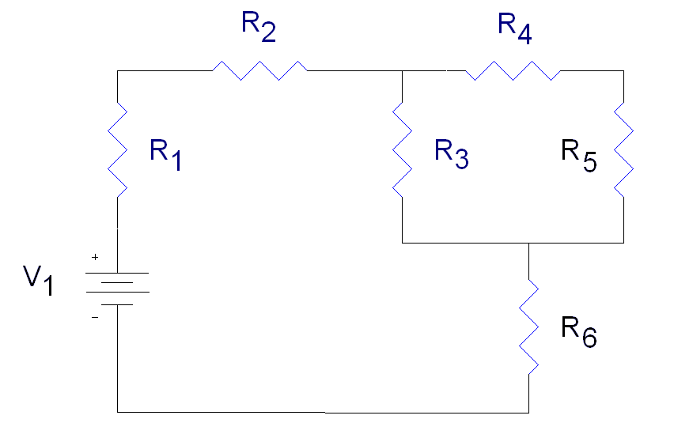
Steps in Nodal Analysis
V_{in}

Slide 9
Steps in Nodal Analysis
Pick one node as a reference node
Its voltage will be arbitrarily defined to be zero
V_{in}

Slide 10
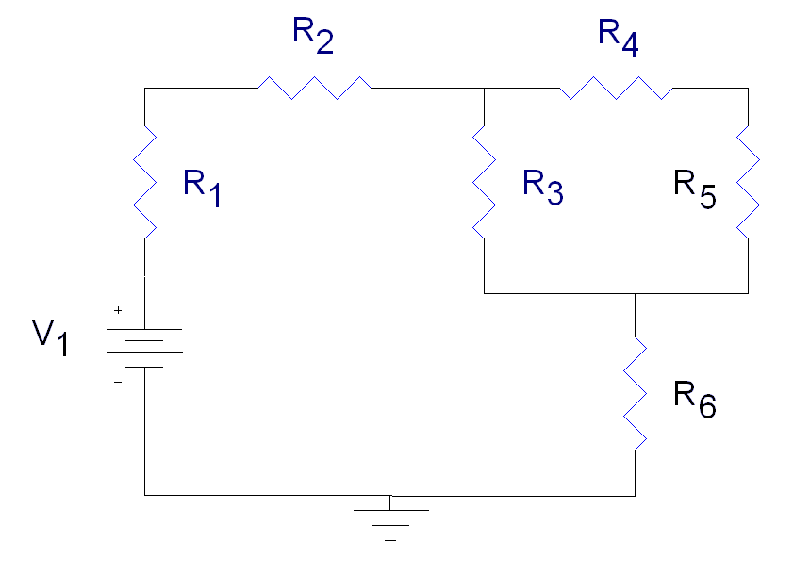
Step 1
Pick one node as a reference node
Its voltage will be arbitrarily defined to be zero
V_{in}

Slide 11
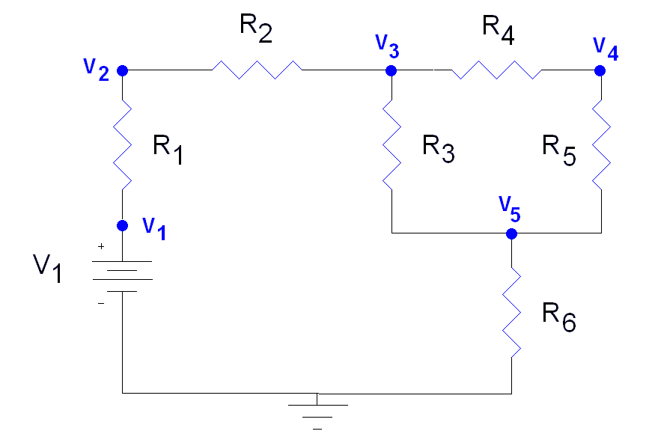
Step 2
Label the voltage at the other nodes
V_{in}

Slide 12
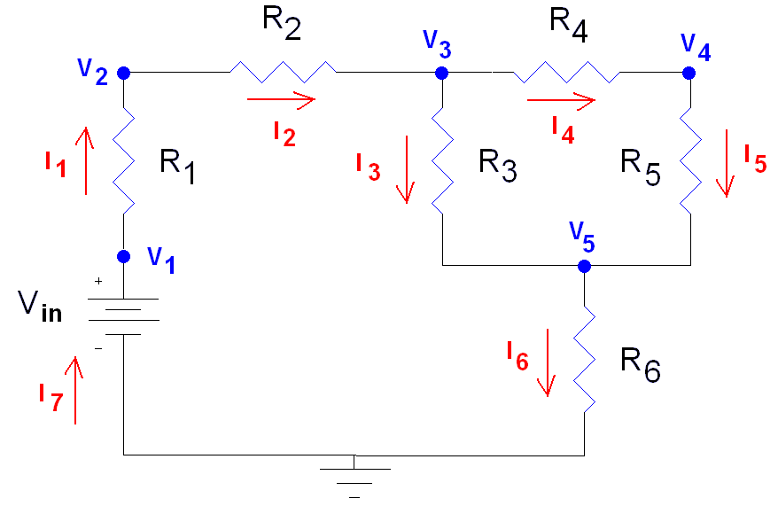
Step 3
Label the currents flowing through each of the components in the circuit

Slide 13
Step 4
Use Kirchoff’s Current Law

Slide 14
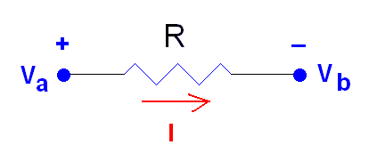
Step 5
Use Ohm’s Law to relate the voltages at each node to the currents flowing in and out of them.
Current flows from a higher potential to a lower potential in a resistor
The difference in node voltage is the magnitude of electromotive force that is causing a current I to flow.

Slide 15
Step 5
We do not write an equation for I₇ as it is equal to I₁

Slide 16
Step 6
Solve for the node voltages
In this problem we know that V₁ = V_{in}

Slide 17
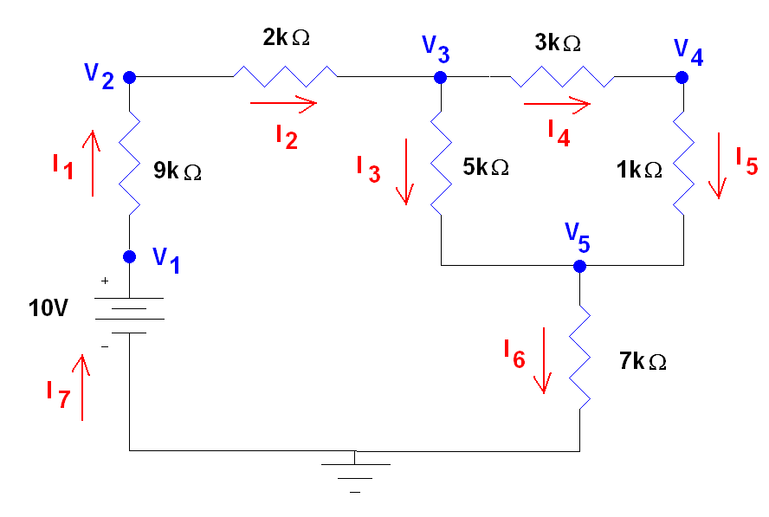
Example 01…
Once the node voltages are known, calculate the currents.

Slide 18
…Example 01…
From Previous Slides

Slide 19
…Example 01…
Substituting in Numbers

Slide 20
…Example 01…
Substituting the results from Ohm’s Law into the KCL equations

Slide 21
…Example 01…
Node Voltages | (V)
V₁ | 10
V₂ | 5.55
V₃ | 4.56
V₄ | 3.74
V₅ | 3.46
Node voltages must have a magnitude less than the sum of the voltage sources in the circuit
One or more of the node voltages may have a negative sign
This depends on which node you chose as your reference node.

Slide 22
…Example 01…
Voltage across resistors | (V)
V_{R1} = (V₁ – V₂) | 4.45
V_{R2} = (V₂ – V₃) | 0.990
V_{R3} = (V₃ – V₅) | 1.10
V_{R4} = (V₃ – V₄) | 0.824
V_{R5} = (V₄ – V₅) | 0.274
V_{R6} = (V₅ – 0V) | 3.46
The magnitude of any voltage across a resistor must be less than the sum of all of the voltage sources in the circuit
In this case, no voltage across a resistor can be greater than 10 V.

Slide 23
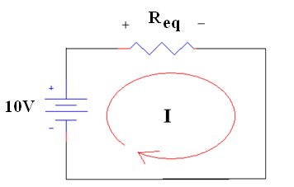
…Example 01
None of the currents should be larger than the current that flows through the equivalent resistor in series with the 10V supply.
R_{eq} = 7+[5||(1+3)]+2+9 = 20.2 kΩ
I_{eq} = 10 / R_{eq} = 10 V/ 20.2 kΩ = 495 µA
Currents | (μA)
I₁ | 495
I₂ | 495
I₃ | 220
I₄ | 275
I₅ | 275
I₆ | 495
I₇ | 495

Slide 24
Summary
Steps in Nodal Analysis
1. Pick one node as a reference node
2. Label the voltage at the other nodes
3. Label the currents flowing through each of the components in the circuit
4. Use Kirchoff’s Current Law
5. Use Ohm’s Law to relate the voltages at each node to the currents flowing in and out of them.
6. Solve for the node voltage
7. Once the node voltages are known, calculate the currents.

Slide 25
Example 02…
Determine the current flowing left to right through the 15 ohms resistor.

Slide 26
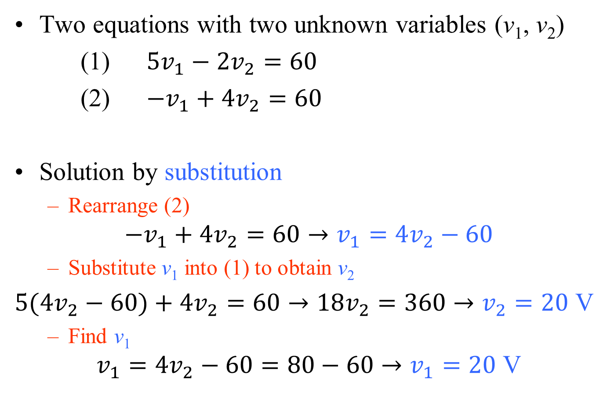
…Example 02…
Two equations with two unknown variables (v₁, v₂)
(1) $5v_{1}−2v_{2}=60$
(2) $−v_{1}+4v_{2}=60$
Solution by substitution
Rearrange (2)
$$−v_{1}+4v_{2}=60→v_{1}=4v_{2}−60$$
Substitute v₁ into (1) to obtain v₂
$5(4v_{2}−60)+4v_{2}=60→18v_{2}=360$ $→v_{2}=20$ V
Find v₁
$$v_{1}=4v_{2}−60=80−60→v_{1}=20 \text{V}$$

Slide 27
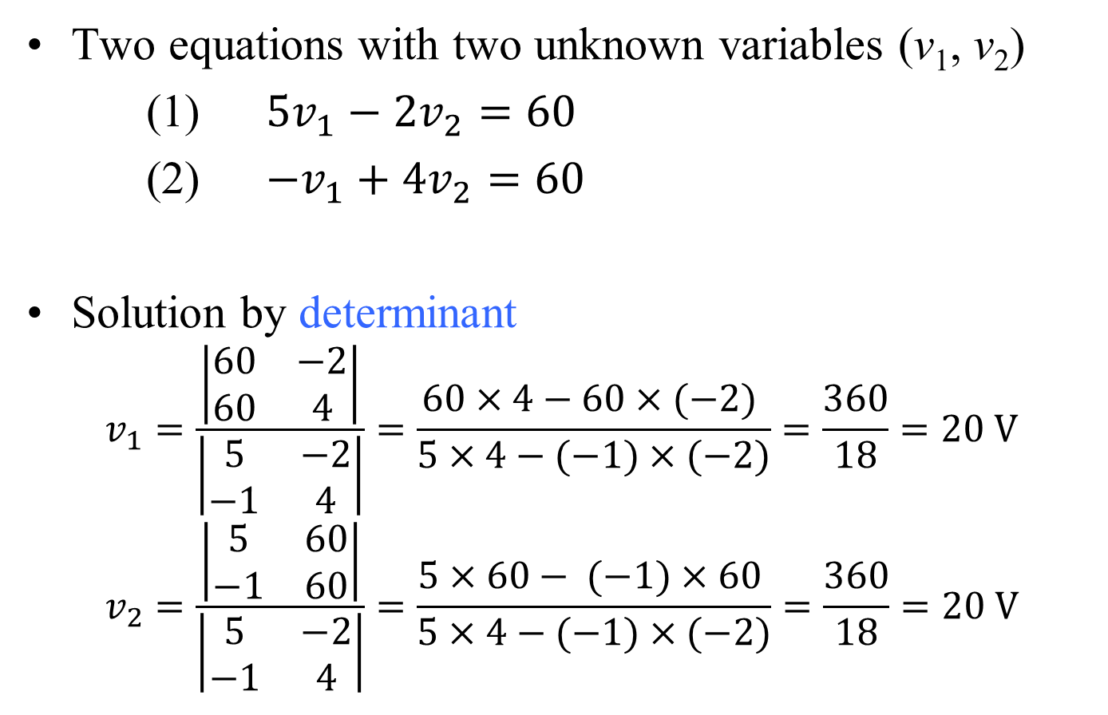
…Example 02
Two equations with two unknown variables (v₁, v₂)
(1) $5v_{1}−2v_{2}=60$
(2) $−v_{1}+4v_{2}=60$
Solution by determinant
$$v_{1}=\frac{\left|\begin{matrix}60 & −2 \\ 60 & 4\end{matrix}\right|}{\left|\begin{matrix}5 & −2 \\ −1 & 4\end{matrix}\right|}=\frac{60×4−60×(−2) }{5×4−(−1)×(−2)}=\frac{360}{18}=20 V$$
$$v_{2}=\frac{\left|\begin{matrix}5 & 60 \\ −1 & 60\end{matrix}\right|}{\left|\begin{matrix}5 & −2 \\ −1 & 4\end{matrix}\right|}=\frac{5×60− (−1)×60 }{5×4−(−1)×(−2)}=\frac{360}{18}=20 V$$

Slide 28
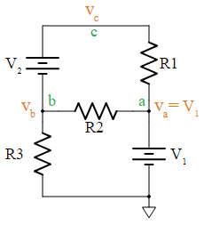


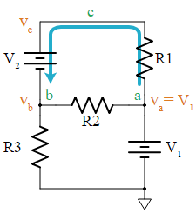



Nodal Analysis with Supernodes
Floating voltage source
a voltage source that does not have either of its terminals connected to the ground node.
A floating source is a problem for the Nodal Analysis
In this circuit, battery V₂ is floating
Applying Nodal Analysis
Using Supernode
The voltage at node c
battery current
the KCL equation at node b
to find currents, Ohm's Law can be used

Slide 29
Nodal Analysis with Supernodes

Slide 30
Example 03…
Determine the node-to-reference voltages in the circuit provided.
identify the nodes & supernodes
write KCL at each node (except the reference)

Slide 31
…Example 03
When we relate the source voltages to the node voltages
When we express the dependent current source in terms of the assigned variables

Slide 32
Mesh Analysis
Technique to find voltage drops within a loop using the currents that flow within the circuit and Ohm’s Law
First result is the calculation of the current through each component
Second result is a calculation of either the voltages across the components or the voltage at the nodes.
Mesh
the smallest loop around a subset of components in a circuit
Multiple meshes are defined so that every component in the circuit belongs to one or more meshes

Slide 33
Mesh Analysis
Identify all of the meshes in the circuit
Label the currents flowing in each mesh
Label the voltage across each component in the circuit
Use Kirchoff’s Voltage Law
-V_{in} + V₁ + V₂+ V₃ + V₆ = 0
-V₃ + V₄+ V₅ = 0
-
V₁
+
+ V₂ -
+ V₄ -
+
V₅
_
+
V₃
_
i₁
i₂
V_{in}
+
V₆
_

Slide 34
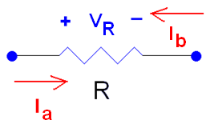
Mesh Analysis
Use Ohm’s Law to relate the voltage drops across each component to the sum of the currents flowing through them.
Follow the sign convention on the resistor’s voltage.
-
V₁
+
+ V₂ -
+ V₄ -
+
V₅
_
+
V₃
_
i₁
i₂
V_{in}
+
V₆
_

Slide 35
Mesh Analysis
Voltage drops on the resistors:
-
V₁
+
+ V₂ -
+ V₄ -
+
V₅
_
+
V₃
_
i₁
i₂
V_{in}
+
V₆
_

Slide 36
Mesh Analysis
Solve for the mesh currents, i₁ and i₂
These currents are related to the currents found during the nodal analysis.
i₁ = I₇ = I₁ = I₂ = I₆
i₂ = I₄ = I₅
I₃ = i₁ - i₂
Once the voltage across all of the components are known, calculate the mesh currents.
-
V₁
+
+ V₂ -
+ V₄ -
+
V₅
_
+
V₃
_
i₁
i₂
V_{in}
+
V₆
_

Slide 37
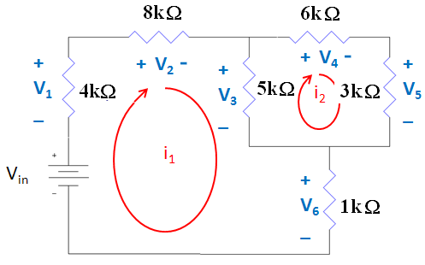
Example 04…
-
V₁
+
12V

Slide 38
…Example 04…
From Previous Slides
-V_{in} + V₁ + V₂ + V₃ + V₆ = 0
-V₃ + V₄ + V₅ = 0

Slide 39
…Example 03…
Substituting the results from Ohm’s Law into the KVL equations
-12 + V₁ + V₂ + V₃ + V₆ = 0
-V₃ + V₄ + V₅ = 0
will result in:
Mesh Currents | (μA)
i₁ | 740
i₂ | 264

Slide 40
…Example 04…
The magnitude of any voltage across a resistor must be less than the sum of all of the voltage sources in the circuit
In this case, no voltage across a resistor can be greater than 12V.
V_{in} = V₁+V₂+V₃+V₆
12 = 2.96+5.92+2.39+0.74
12 V= 12.01 V
0.01 V difference is caused by rounding error
Voltage across resistors | (V)
V_{R1} = i₁R₂ | 2.96
V_{R2} = i₂ R₂ | 5.92
V_{R3} =(i₁ – i₂) R₃ | 2.39
V_{R4} = i₂ R₄ | 1.59
V_{R5} = (V₄ – V₅) | 0.804
V_{R6} = (V₅ – 0V) | 0.740

Slide 41
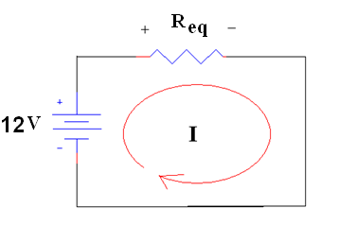
…Example 04
None of the mesh currents should be larger than the current that flows through the equivalent resistor in series with the 12V supply.
R_{eq} = 1+[5||(3+6)]+8+4 = 16.2 kΩ
I_{eq} = 12 / R_{eq} = 12 V/ 16.2 kΩ = 740 µA
Currents | (μA)
I_{R1} = i₁ | 740
I_{R2} = i₁ | 740
I_{R3} = i₁- i₂ | 476
I_{R4} = i₂ | 264
I_{R5} = i₂ | 264
I_{R6} = i₁ | 740
I _{Vin} = i₁ | 740

Slide 42
Summary
Steps in Mesh Analysis
1. Identify all of the meshes in the circuit
2. Label the currents flowing in each mesh
3. Label the voltage across each component in the circuit
4. Use Kirchoff’s Voltage Law
5. Use Ohm’s Law to relate the voltage drops across each component to the sum of the currents flowing through them.
6. Solve for the mesh currents
7. Once the voltage across all of the components are known, calculate the mesh currents.

Slide 43
Example 05
Determine the loop currents i₁ and i₂

Slide 44
Example 06
Determine the power supplied by the 2 V source
Mesh 1
Mesh 2
Power absorbed by the 2 V source
Actually 2.474 W is supplied

Slide 45
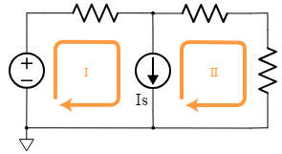
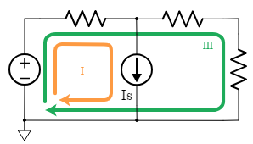
Mesh Analysis with Supermeshes
Consider the following circuit.
Both mesh I and mesh II go through the current source.
It is possible to write and solve mesh equations for this configuration.
Using supermesh
You can drop one of the meshes and replace it with the loop that goes around both meshes, as shown here for loop III.
You then solve the system of equations exactly the same as the Mesh Analysis

Slide 46
Mesh Analysis with Supermeshes

Slide 47
Example 07
Determine the current i as labeled in the circuit.
Supermesh
Mesh 2
Independent source current is related to the mesh currents
+
-
+
-
+ -
+
-
+
-

Slide 48
Nodal vs. Mesh Analysis: A Comparison
The following is a planar circuit with 5 nodes and 4 meshes.
Planar circuits are circuits that can be drawn on a plane surface with no wires crossing each other.
Determine the current i_{x}

Slide 49
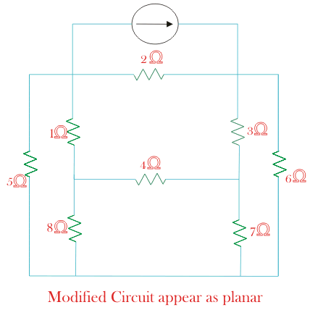
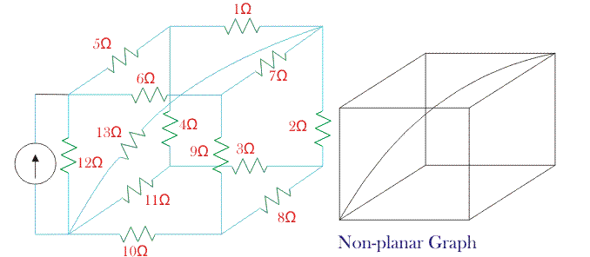
Planar vs Non-planar circuits
Planar
Non-planar

Slide 50
Nodal vs. Mesh Analysis: A Comparison
Using Nodal Analysis
Although we can write four distinct equations, there is no need to label the node between the 100 V source and the 8 ohm resistor, since that node voltage is clearly 100 V.
We write the following three equations:
Solving, we find that

Slide 51
Nodal vs. Mesh Analysis: A Comparison
Using Mesh Analysis
We see that we have four distinct meshes
However it is obvious that i₄= −8 A
We therefore need to write three distinct equations.
Writing a KVL equation for meshes 1, 2, and 3:
Solving, we find that

